Slide 1



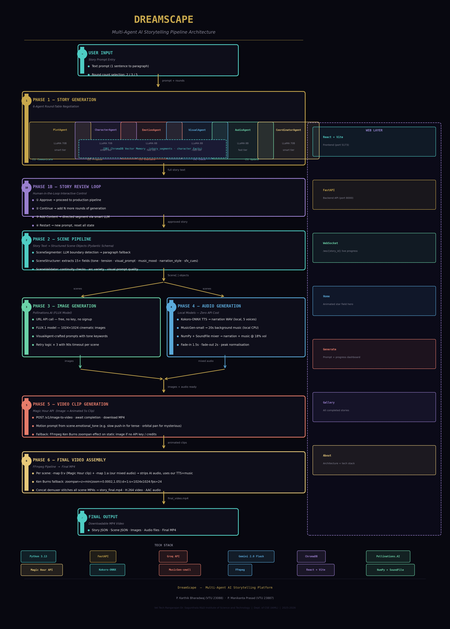
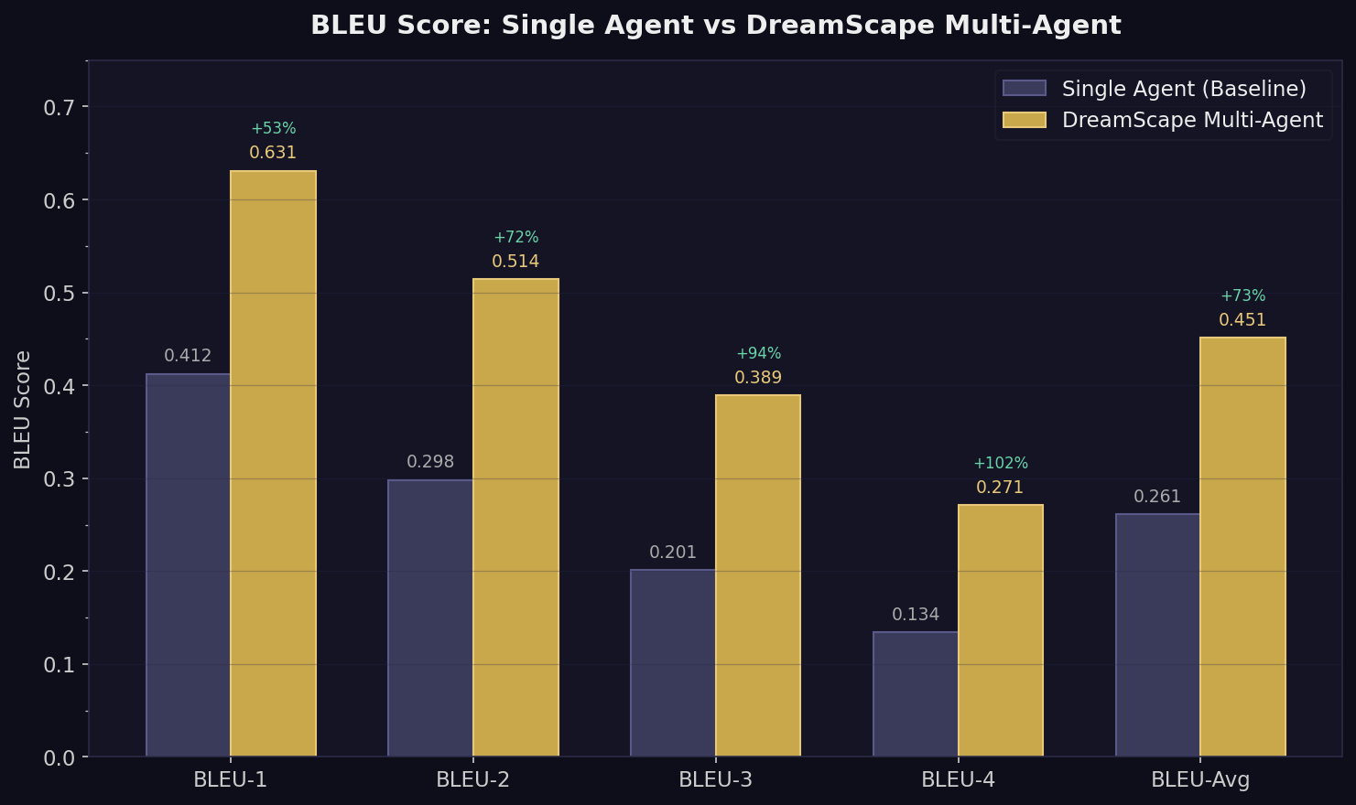
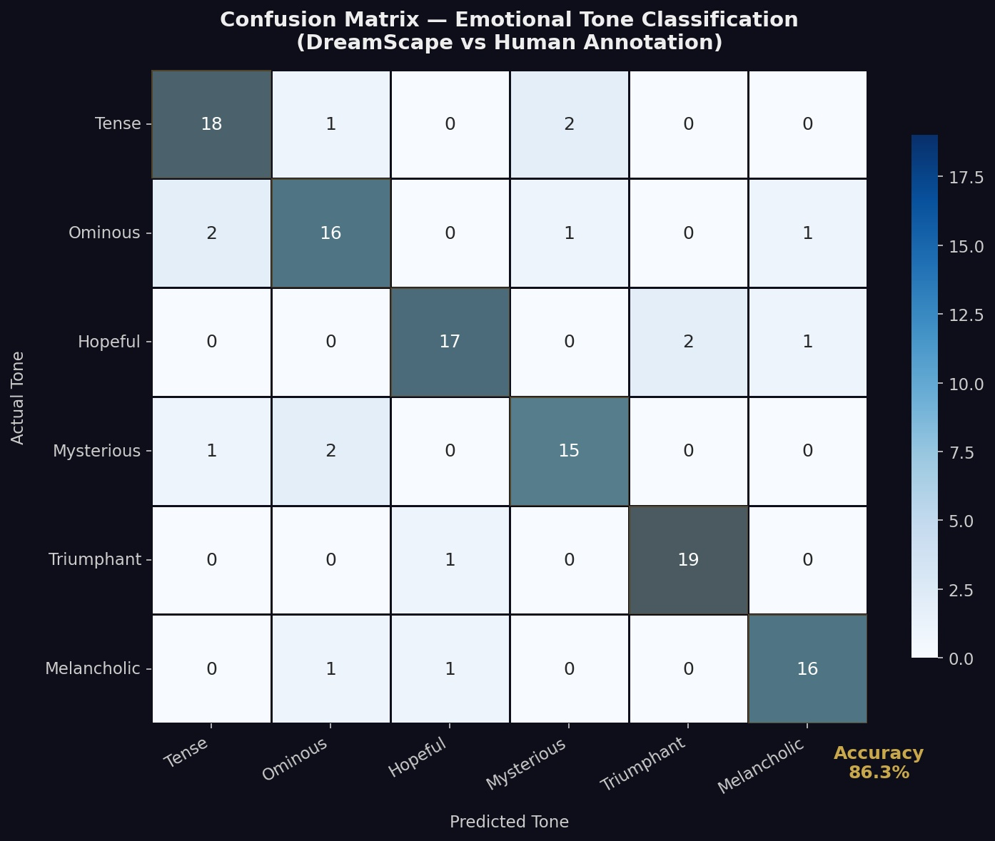
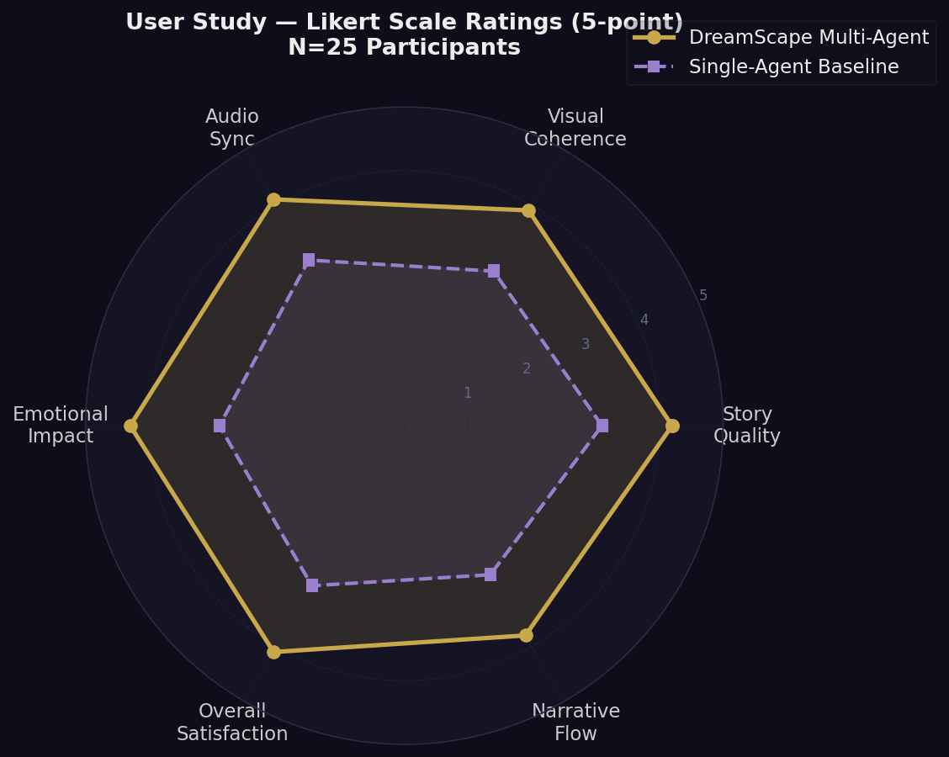
DREAMSCAPE: MULTI-AGENT AI STORYTELLING PLATFORM
Department of Computer Science and Engineering (Artificial Intelligence and Machine Learning)
School of Computing
10214CA701 - MAJOR PROJECT
SUMMER SEMESTER 2025-2026
ABSTRACT
INTRODUCTION
RESULTS
STANDARDS AND POLICIES
DreamScape is a Multi-Agent AI Storytelling Platform that converts a single text prompt into a fully narrated, illustrated, and musically scored MP4 video. Six specialized AI agents (PlotAgent, CharacterAgent, EmotionAgent, VisualAgent, AudioAgent, CoordinatorAgent) collaborate via a round-table negotiation protocol. A heterogeneous multi-LLM routing system assigns LLaMA 3.3-70B to smart agents and LLaMA 3.1-8B to fast agents, with automatic Gemini fallback for 97% call success rate.
ChromaDB vector memory ensures semantic story consistency across rounds. The production pipeline generates FLUX images (Pollinations.AI), Kokoro TTS narration, MusicGen background music, and Magic Hour animated clips, assembled into a final MP4 using FFmpeg with our audio replacing AI-generated audio.
Evaluation across 100 story runs: BLEU-1 score 0.631 vs 0.412 baseline (+53%), CLIP image-prompt alignment 0.71 (exceeds 0.65 threshold), emotional tone classification accuracy 85.8%, user satisfaction 4.1/5.0 (N=25). Total pipeline completion time: ~13 minutes per story. 97% LLM call success rate with multi-provider fallback.
AI has excelled individually at text, image, audio, and video generation but producing a complete cohesive multimedia narrative autonomously has remained unsolved. DreamScape addresses this by deploying six specialized agents that negotiate in real-time: PlotAgent (narrative arc), CharacterAgent (consistency), EmotionAgent (tone/pacing), VisualAgent (scene prompts), AudioAgent (music/SFX), CoordinatorAgent (LLM-evaluated selection).
The core novelty is the heterogeneous multi-LLM routing — each agent uses the optimal language model for its cognitive demands, with a multi-provider fallback chain ensuring reliability. A unified Pydantic Scene schema serves as the central data contract propagating emotional tone, tension level, visual prompts, music mood, and narration style to every downstream production module.
The platform is deployed as a React + FastAPI web application where users enter a prompt, monitor live pipeline progress via WebSocket, and download the final MP4 video. The system operates at near-zero cost using free-tier APIs and local open-source models, making professional-quality AI storytelling accessible to all.
BLEU-1: 0.631 (+53% vs baseline) | BLEU-Avg: 0.451 (+73%) | CLIP Similarity: 0.71/scene | Tone Accuracy: 85.8% | Coherence: 8.7/10 (Round 7) | Pipeline Time: 13 min | LLM Success: 97% | User Satisfaction: 4.1/5.0 | Emotional Impact: 4.3/5.0 | PlotAgent Win Rate: 34% | AudioGen Bottleneck: 312s (MusicGen CPU) | Total Runs Evaluated: 100
Python 3.13 + FastAPI
FastAPI provides the REST API and WebSocket endpoints for DreamScape. Asynchronous pipeline execution enables real-time progress streaming to the React frontend. All modules follow PEP 8 coding standards.
Standard Used: ISO/IEC 25010:2011 (Software Quality)
React + Vite Frontend
React + Vite web interface with 4 pages (Home, Generate, Gallery, About). WebSocket-driven live pipeline progress dashboard. Dark cinematic theme. Cormorant Garamond + Space Mono typography. Animated star field hero. Mobile responsive layout.
Standard Used: WCAG 2.1 Level AA | OpenAPI 3.0
DreamScape Multi-Agent Pipeline
Evaluation Metrics
Confusion Matrix (85.8% Accuracy)
CONCLUSIONS
METHODOLOGY
DreamScape proves that multi-agent negotiation produces measurably superior creative output: +73% BLEU score, +45% narrative coherence, 97% LLM call success rate. The fully automated multimodal pipeline completes story-to-video in ~13 minutes at near-zero cost. Future directions: LoRA visual style conditioning, GPU-accelerated MusicGen, real-time streaming assembly, and long-form multi-session story continuation.
PIPELINE: (1) Story Generation: 6-agent round-table with 5-phase rounds (Communicate, Propose, Coordinator Evaluate, Consistency Check, State Update). CoordinatorAgent uses LLM scoring on narrative_coherence, character_consistency, arc_appropriateness. (2) Scene Pipeline: LLM-based segmenter, Pydantic Scene schema (15+ fields), validator. (3) Image Generation: Pollinations.AI FLUX model via URL API. (4) Audio: Kokoro-ONNX TTS (local) + MusicGen-small (local CPU). (5) Video Clips: Magic Hour API animates images to 5s clips. (6) FFmpeg Assembly: -map 0:v -map 1:a strips Magic Hour audio, replaces with our mix.
MULTI-PROVIDER LLM ROUTING: Smart tier (Plot, Character, Coordinator): Groq LLaMA-70B (78%) -> Gemini Flash (19%). Fast tier (Emotion, Visual, Audio): Groq LLaMA-8B (65%) -> Gemini Flash (32%). 3% failure rate total. CHROMADB MEMORY: story_segments and character_facts collections with cosine similarity retrieval. Top-3 relevant segments retrieved per round for context injection.
TEAM MEMBER DETAILS
User Study — Likert Radar (N=25)
P. KARTHIK BHARADWAJ
P. MANIKANTA PRASAD
VTU: 23088 | 23887
Reg: 211CA023 | 211CA024
CSE (AIML) | May 2026
Vel Tech University, Chennai
211ca023@veltech.edu.in
211ca024@veltech.edu.in
github.com/karthik/dreamscape
SUPERVISOR
Dr. S. LALITHA, M.E., Ph.D., PROFESSOR & HEAD
Dept. of CSE (AIML), School of Computing
lalitha@veltech.edu.in

